Slide 1

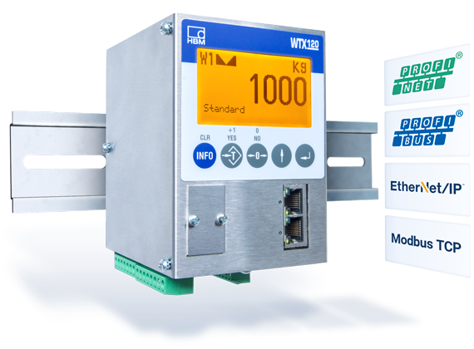
Connection via Modbus TCP WTX120
Version 1.5.3

Slide 2
Agenda :
Prerequisites
Hardware
Software
Step-by-Step
Run Example Applications
Programing own Window App Using the API
Overview Structure & Communication Flow
Code Example Using the API
Change Settings of the WTX120
Calibration
Outlook & Link Collection

Slide 3
1.1 Prerequisites – Hardware
HBM WTX120 weighing terminal
Supply voltage for WTX120 (12V-30V, DC)
RJ45 Cable (“LAN” Cable)
A weighing sensor, e.g. HBM PW6C
Computer with LAN-port or which is connected to the same network as the WTX
Visual Studio 2017 hardware requirements:
Min. 1.8 GHz processor (dual-core recommended)
Min. 2 GB RAM (4 GB recommended)
Around 20-50 GB hard disk space

Slide 4
1.2 Prerequisites – Software
Windows operating system, min. Win7 SP1
(for programming also macOS possible)
Min. Visual Studio (VS) 2013
.Net Version 4.5.2

Slide 5
1.2 VS Community License - Extract
“For organizations
An unlimited number of users within an organization can use Visual Studio Community for the following scenarios: in a classroom learning environment, for academic research, or for contributing to open source projects
For all other usage scenarios: In non-enterprise organizations, up to five users can use Visual Studio Community. In enterprise organizations (meaning those with >250 PCs or >$1 Million US Dollars in annual revenue)
For individuals
Any individual developer can use Visual Studio Community to create their own free or paid apps.”
From https://www.visualstudio.com/vs/community/ (02/14/2018)
After 30 days you have to log in with a Microsoft account to unlock the test version
Everyone else needs another license!

Slide 6
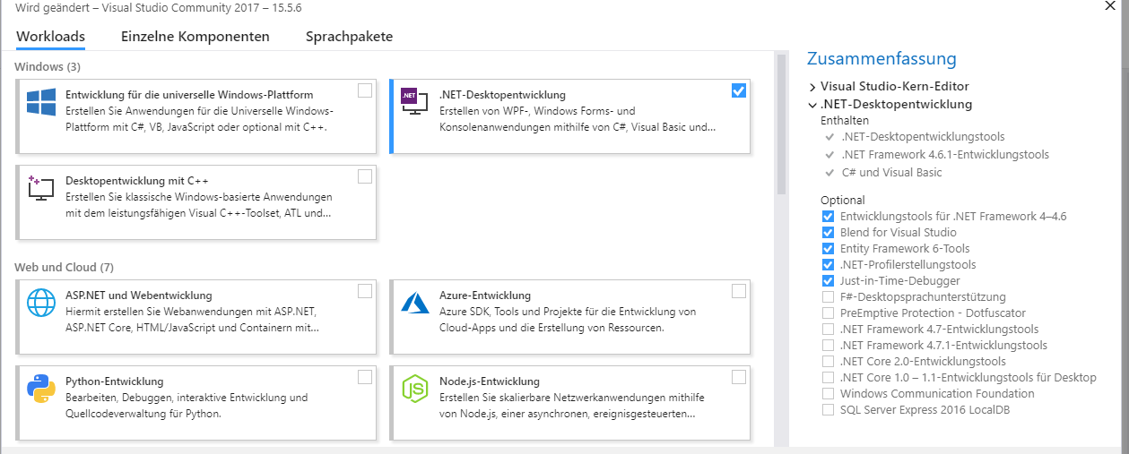
Step-by-Step - Installation
You can find all required links for downloads in the Link-Collection
Install VS with .NET-Development extension or basic version and install required packages afterwards
Download ModbusTCP_WTX from GitHub
Picture: VS Required Tools and Features

Slide 7
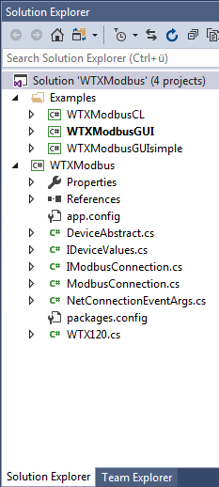
2 Step-by-Step - Connect WTX & Get Started
Connect WTX120 with the same network as your PC Note: WTX does not support DHCP currently, only fixed IP
Or connect directly to your PC, the IP-address in WTX must be the same, where the subnet-mask is 255, and different, where it is 0.
Open WTXModbus.sln in the WTXModbus folder in the
downloaded folder
Note: You need internet access during the first build,
because WTXModbus downloads 2 NuGet- packages
one-time
Project overview: 3 example applications: one command
line application (CL), two graphic applications (GUI),
and the API WTXModbus.
Picture: Project overview– Solution explorer

Slide 8
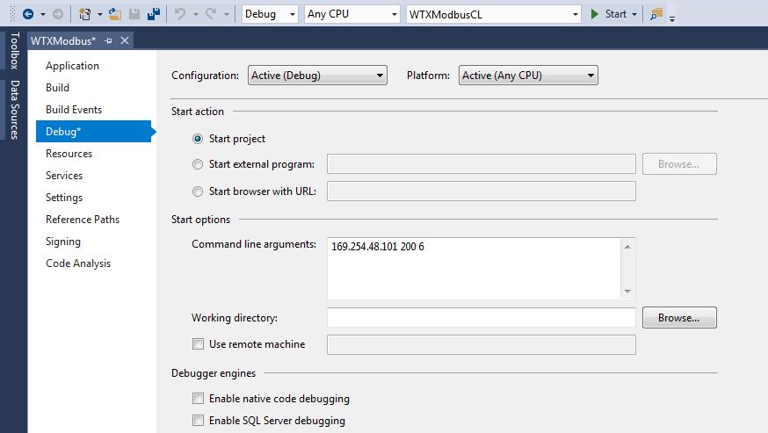
2.1 Step-by-Step - Example Application
Start a demo example: Choose an app
Note: If you choose WTXModbusCL, you have to set the IP in the VS project properties menu as an argument. Connection establishs automatically after start.
Choose command line (CL) or a graphic version (GUI)
Insert the IP of your WTX
Picture: WTXModbusCL Project Menu (Project-> WTXModbusCL Properties… -> Debug)
If a failure occurs during build, probably you have not installed all required VS packages

Slide 9
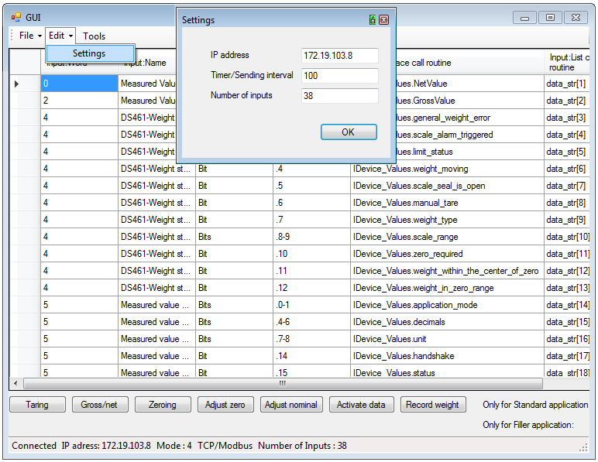
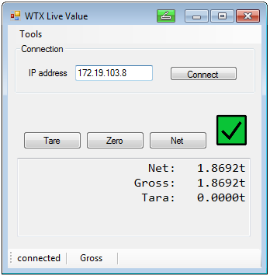
2.1 Step-by-Step - Example Application: GUIs
GUI example apps can change their IP graphically, also during a run
WTXModbusGUI:
Start by clicking File -> Start
WTXModbusGUIsimple:
Start by clicking Connect

Slide 10
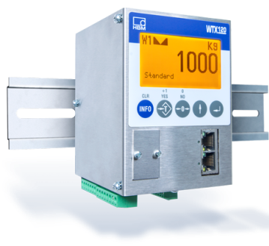
2.2.1 Step-by-Step - Use the API: Overview Structure
<<interface>>
IModbusConnection
_________________
_________________
+Connect():void
+Write():void
+Read(…):void
<<interface>>
IDeviceValues
_________________
~NetValue:int
~GrossValue:int
~status:int
~handshake:int
….
~DataUpdateEvent:
event EventHandler
communicates
via Modbus/TCP protocol
implements
implements
ModbusConnObj : ModbusConnection
_________________
+RaiseDataEvent:
event EventHandler
WTXObj : WTX120
_________________
-ModbusConnObj:
ModbusConnection
ModbusConnection uses an event handler to signalize that data has been read
1
has
IDeviceValues defines the properties (attributes) for values from the WTX device and an eventhandler to check if new data has been read and converted afterwards

Slide 11
2.2.1 Step-by-Step - Use the API: Overview Communication Flow
Real World
API
ModbusConnObj : ModbusConnection
________________
+is_connected:bool
+IP_Adress:String
WTXObj : WTX120Modbus
______________________
-aTimer:Timer
______________________
+WTX120Modbus
(connection, timerInterval)
4. CallbackMethod()
1. Connect()
has
3. Async_Call(Opcode,
CallbackMethod)
2. OnTimedEvent()
API
User Interface (Application)
6. DataUpdateEvent?.Invoke(this, e);
5. WTXObj.DataUpdateEvent
+= ValuesOnConsole;
Create an object of class ModbusConnection and WTX120Modbus with a timer interval as a parameter, then call Connect()
aTimer calls periodically Async_Call()
The method Async_Call() updates the values in WTXObj via ModbusConnObj
CallbackMethod() in WTXObj is executed as soon as the values are up-to-date
Via the event based call WTXObj.DataUpdateEvent += ValuesOnConsole by the application …
The data is called up after .Invoke() in WTX120Modbus within method UpdateEvent() and fetched
Picture: Example User Interface “WTXModbusSimpleGUI”

Slide 12
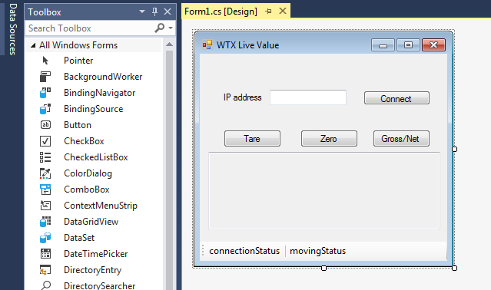
2.2.2 Step-by-Step - Use the API: Create your own Application
For GUI
Add a new Windows Forms App project to the Solution
Use the VS Toolbox to create a display window (drag & drop)
Double-click on buttons or timer to create empty methods in code
Use F7 to switch to the programming view
For CL
Use Console App project
For both
Use methods as mentioned
on the previous slides to
create your program
Picture: VS Toolbox with an Example Window

Slide 13
2.2.2 Step-by-Step - Use the API: Code Example (1)
Code Example
using Hbm.Devices.WTXModbus;
using WTXModbus;
namespace CodeExample
{
public class ClassExample
{
private ModbusConnection ModbusObj;
private WTX120Modbus WTXObj;
public ClassExample()
{
int interval=1000;
ModbusObj = new ModbusTCP(IPAddress);
WTXObj = new WTX120Modbus(ModbusObj, interval);
WTXObj.getConnection.Connect();
// equal to ModbusObj.Connect();
WTXModbusObj.DataUpdateEvent += ValuesOnConsole;
}
private void ValuesOnConsole(object sender,
NetConnectionEventArgs<ushort[]> e)
{
Console.WriteLine(WTXObj.NetValue);
Console.WriteLine(WTXObj.GrossValue);
}
}
}
Description
Required imports
IPAddress is a string like “192.168.21.1” and interval is in milliseconds
Create an object of ModbusConnection with an IP address of the WTX device and an object of WTX120Modbus with the created ModbusConnection object and a timer interval
Connect your device
Add your method ValuesOnConsole to the Eventhandler DataUpdateEvent
The method is called from the API once the data is read from your WTX device and translated to strings
Here ValuesOnConsole updates the console with the newly arrived net and gross values. Write your specific code here!
See next slide for another example of ValuesOnConsole

Slide 14
2.2.2 Step-by-Step - Use the API: Code Example (2)
Code Example
private void ValuesOnConsole(object sender,
NetConnectionEventArgs<ushort[]> e)
{
// To print the net value as a string.
Console.WriteLine(WTXModbusObj.get_data_str[0]);
// To print the gross value as a string.
Console.WriteLine(WTXModbusObj.get_data_str[1]);
// To print the limit status as a string.
Console.WriteLine(WTXModbusObj.get_data_str[4]);
// As ushort or integer values:
Console.WriteLine(WTXObj.NetValue); Console.WriteLine(WTXObj.GrossValue);
Console.WriteLine(WTXObj.limit_status);
}
Description
ValuesOnConsole() updates the console with the newly arrived values from your WTX device
In the method ValuesOnConsole() you only have to call the string array via WTXModbusObj.get_data_str and print the values on the console like in the code example
The values like WTX.NetValue and WTX.GrossValue have ushort as type. To convert them to strings there are methods available e.g. comment_limit_status() or measurement_with_comma() in the class WTX120Modbus

Slide 15
2.2.3 Step-by-Step: Writing into the WTX120 device
Establish a connection
Call WTX_obj.Async_Call(Op_Code, CallbackMethod)
The callback method is called once the writing is completed to the WTX120. Choose the content by yourself.
Choose the function with Op_Code according to the table on the right.
Op_Code | Meaning
0x1 | Taring
0x2 | Switch Gross / NET
0x40 | Zeroing
0x80 | Adjust zero
0x100 | Adjust nominal
0x800 | Activate data
0x1000 | Manual taring
0x4000 | Weight storage
(For more see WTX manual, chapter PLC link)
Code Example
private void buttonTare_Clicked(object sender, EventArgs e)
{
WTX_obj.AsyncCall(0x1, WriteDataReceived);
}
private void WriteDataReceived(IDeviceValues_obj)
{
textBoxAusgabe.Text = “Write executed”;
}

Slide 16
2.2.4 Step-by-Step: Calibration
There are two possibilities:
Calculate the values for a dead load and a nominal load in a ratio in mV/V and write in into the WTX registers
Call WTXObj.Calculate(preload, capacity) on your WTX120 object with preload and capacity as double in mV/V
Calibration with a reference weight
Call WTXObj.MeasureZero() with unloaded scale
Call WTXObj.Calibrate(normalizedWeight, weightAsString) with int normalizedWeight is the reference weight in the current unit multiplied with 10^(WTXObj.decimals)
Code Example
// Unload scale
WTXObj.MeasureZero();
// put reference weight e.g. 2kg on the scale. WTX display shows weights in kg (WTXObj.unit=0)
Int weight = 2;
Int normalizedWeight = weight * Math.pow(10, WTXObj.decimals);
WTXObj.Calibrate(normalizedWeight, weight.toString());

Slide 17
3 Outlook
If you want to implement an own application, it is recommended to be guided by the interfaces ‚IDeviceValues‘ and ‚IModbusConnection‘. The latter represents the connection with TCP/Modbus to the WTX and ‚IDeviceValues‘ represents the available values, which can be easily called via the interface from your application.
For more details or functions have a look at the descriptions or at the WTX120 manual
An application with Jetbus and Modbus together is in work to get more informations and redundance.

Slide 18
3 Link Collection
WTX120 Website:
https://www.hbm.com/en/6304/wtx120-industrial-and-legal-for-trade-weighing-terminal/
WTX120 Manual:
https://www.hbm.com/fileadmin/mediapool/hbmdoc/technical/a4500.pdf
ModbusTCP API on Github: (unofficial, later …/HBM)
https://github.com/leistner/ModbusTCP_WTX
Microsoft Visual Studio:
https://www.visualstudio.com/vs/

